Slide 1
AGI in Fintech Workshop
How to do Finance AI: end to end
https://singularity-dao.github.io/agi-fintech/
Chris Poulin

Slide 2
Example Workflow
01
02
03
04
Asset management goals
Data Selection
Risk/Predictive Methods
Predictive Performance
08
07
06
05
Optimization
Operational Risks
Trading Execution
Portfolio Analysis

Slide 3
01: Asset management goals
Classical assets?
Crypto?
How do you measure success? get out?
Equites? Structured (Bonds)? FX? Distressed?
Resources
https://www.lookintobitcoin.com/charts/
https://www.twosigma.com/articles/risk-analysis-of-crypto-assets/
(Thanks to Kevin Chen)

Slide 4
02: Data Selection
Commodities players
Equites players
Crypto players
Major Coins? (BTC/ETH) Alt-Coins?
Resources:
https://cryptoquant.com/
https://www.lookintobitcoin.com/charts/

Slide 5
03: Risk/Predictive Methods
Signal?
Automation?
Agent based?
Resources:
How to Code a Trading Bot in Python
https://www.youtube.com/watch?v=s8uyLscRl-Q
Algorithmic Trading Using Python
https://www.youtube.com/watch?v=xfzGZB4HhEE
Stock Prediction Using Tensorflow (RNN/LSTM)
https://www.youtube.com/watch?v=p5pDBGoJmR0

Slide 6
04: Predictive Performance
Validation
Time Series
Hit Rate
Regime Change
Other common traps (common)
Resources:
https://towardsdatascience.com/model-validation-techniques-for-time-series-3518269bd5b3

Slide 7
05: Portfolio Analysis
Paper Trades
Stress testing
Draw down models
Financial Risk Metrics
Resources:
https://wallethacks.com/best-portfolio-analyzers/
(Mostly Personal Finance examples)

Slide 8
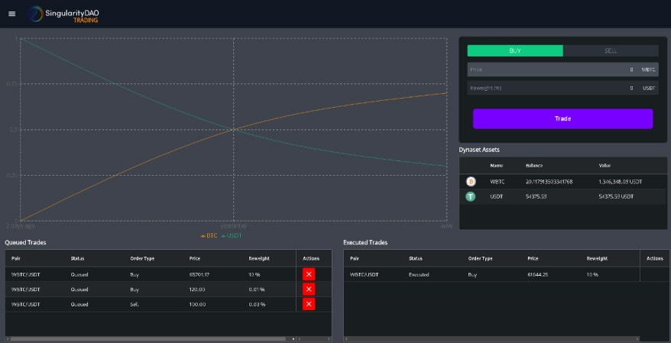
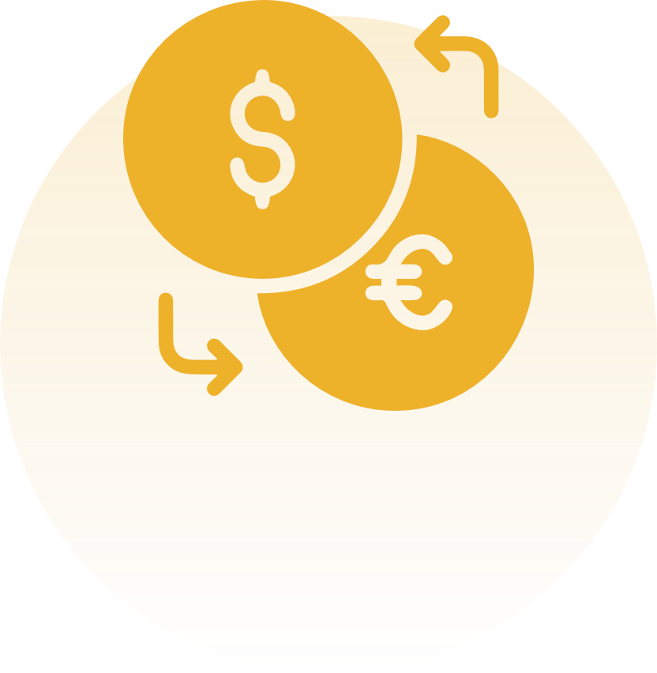
06: Trading Execution
Exchange based?
e.g. Interactive Brokers/Trade Station
"coauthors placed 85,000 market trades at 6 different brokers. Same stock, same amount, same time. Findings? 1. Crazy price differences (-0.07% to -0.46%). 2. No way to predict it and 3. Paid Order Flow has no impact.“ Schwartz et al
Source: Singularity DAO
Crypto
Centralized (e.g. Binance) Decentralized (e.g. Uniswap)
Resources:
https://www.tradestation.com/why-tradestation
https://papers.ssrn.com/sol3/papers.cfm?abstract_id=4189239
https://dydx.exchange/

Slide 9
07: Operational Risks
Counter Party Risk
Other end of the trade
Fintech IT
Resources:
Order-book modelling and market making strategies
https://arxiv.org/abs/1806.05101

Slide 10
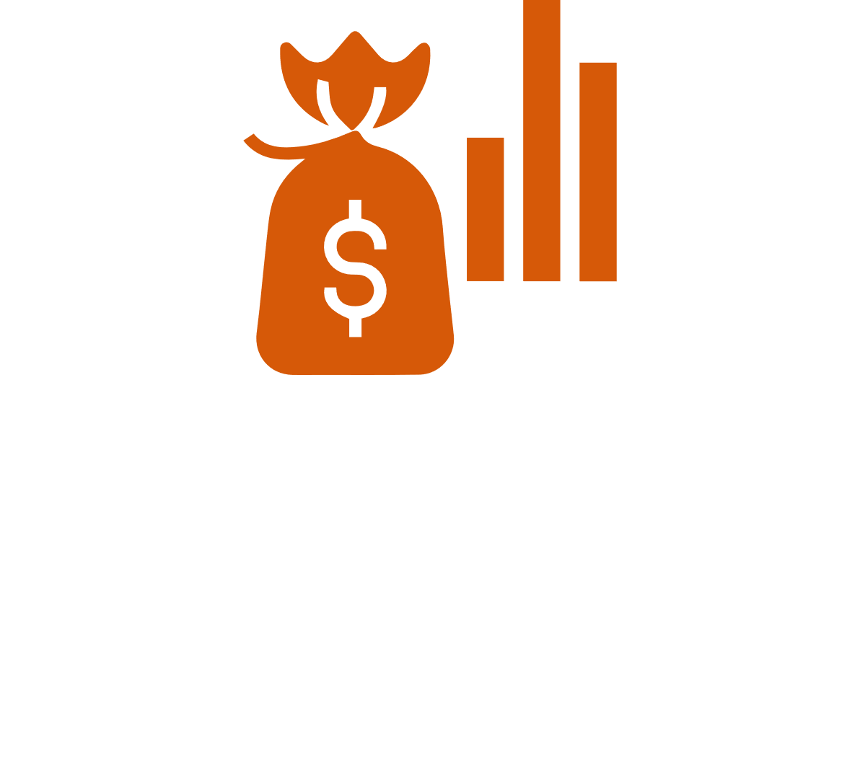
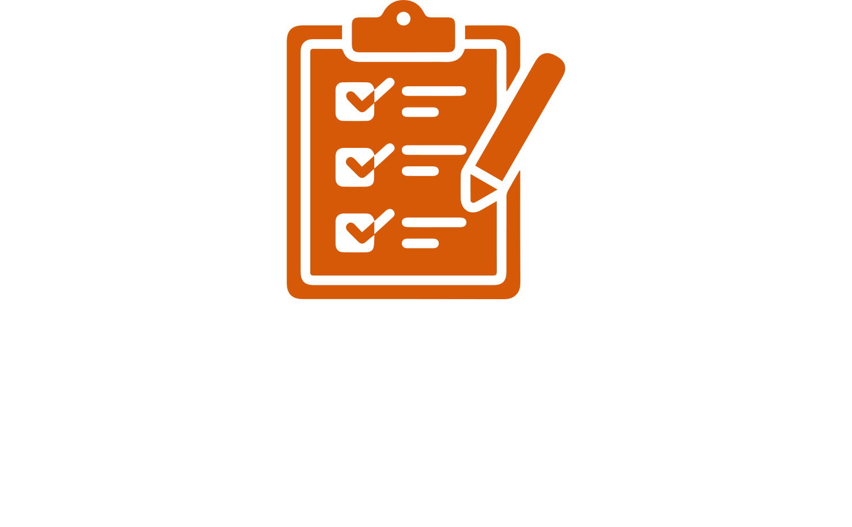
08: Optimization
Virtuous cycle of development
You can make money, but how? (Not easy)
Hyper-organized
Blue moons
Resources:
https://letian-wang.medium.com/from-reinforcement-gamer-to-reinforcement-trader-8b0a7ef8b53f

Slide 11
Our Workflow Revisited
01
02
03
04
Asset management goals
Data Selection
Risk/Predictive Methods
Predictive Performance
08
07
06
05
Optimization
Operational Risks
Trading Execution
Portfolio Analysis

Slide 12
Thank you
https://singularity-dao.github.io/agi-fintech/
Chris Poulin
cpoulinwave@gmail.com
chris.poulin@singularitydao.ai

